Slide 1

NF06A Project : Le Marcel Manager
Mathurin LEMOINE
P22

Slide 2
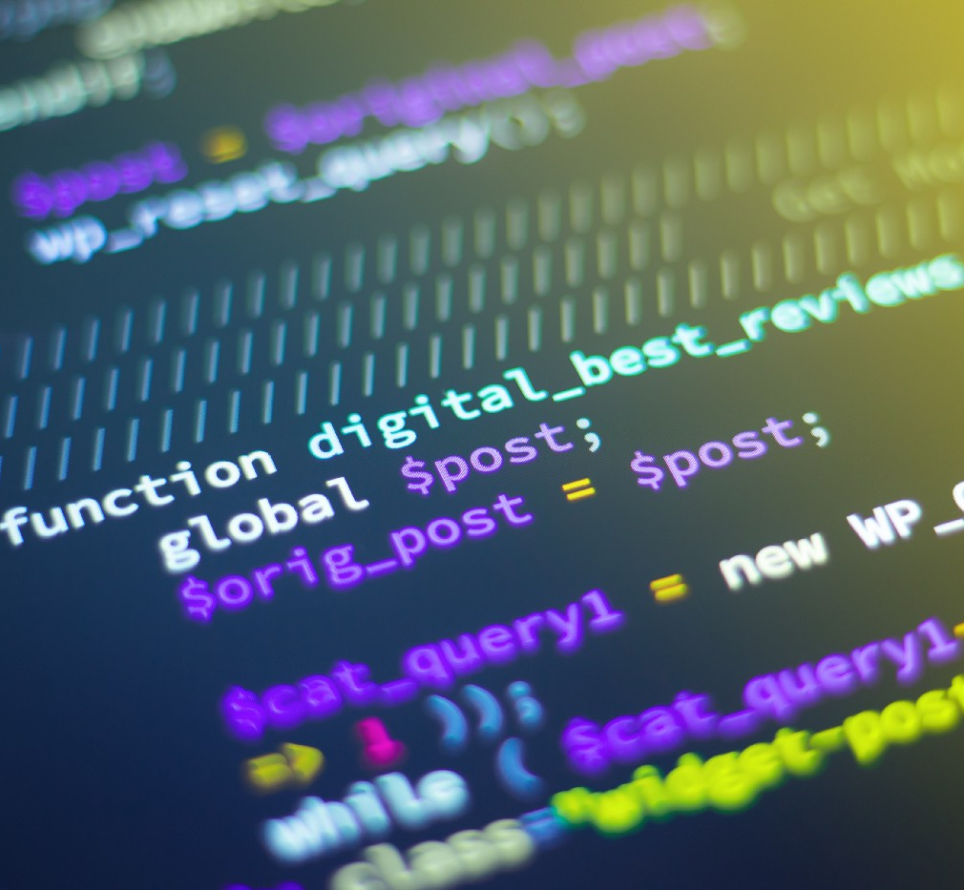
Goals of the project
Main objectives // functions to develop :
Import / export bikes and stations database
Dock a new bike to a station
Display stations and their bikes
Rent a bike
Summary of the system
Execute the maintenance of defective bikes
NF06A – Mathurin lemoine – P22

Slide 3

Difficulties encountered
Learning how to use GitHub to keep a backup of the program in case of loss
Solution: Watching tutorials on YouTube and reading forums
How to self-define the classes
Solution: Reading forums and python documentation
How to import/export on the csv files
Solution: Used csv and pandas’ library and their documentation
How to use the networkx library
Solution: Read forums, watch videos and read documentation
Implement the C function in python using CTypes
Solution: Find videos that explains the process, read forums and ask the professor for help to generate the DLL as it was not working
How to use the doxygen documentation
Solution: Watch videos explaining the process + documentation
NF06A – Mathurin lemoine – P22

Slide 4
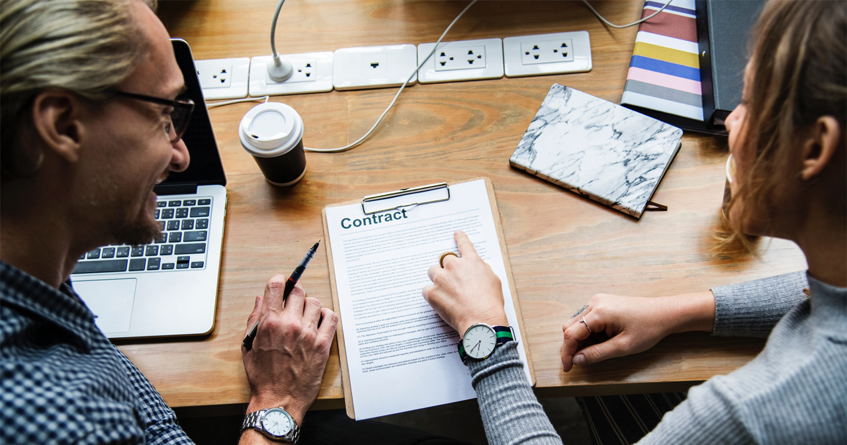
Solving the TSP
Finding the best route to get all the defective bikes traveling the least distance possible
Difficulties:
Find a way to return an array usable in python
Define a structure in C to store UID and coordinates
Display the resulting path using networkx
NF06A – Mathurin lemoine – P22

Slide 5
Additional features
User panel
Rent a bike
Dock a new bike
Maintenance of defective bikes
Display the stations
Summary of the situation
User panel to navigate between the functions easily
Created requirements.txt to initiate the project with needed libraries
NF06A – Mathurin lemoine – P22

Slide 6
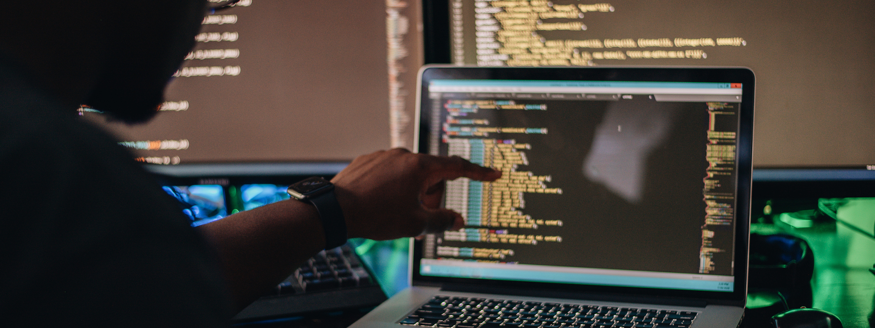
Thank you for your attention
Feel free to ask any questions !

